Slide 1
Lab Exercise 2

Slide 2
Image, image Cap and MM
Write html Code to embed image, image cap, audio and video player to html document

Slide 3
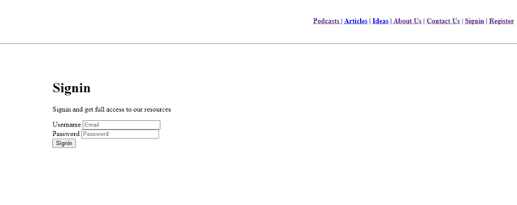
Form Start practicing with html form using a simple sign in page

Slide 4
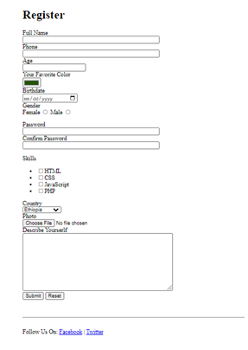
Create register form add the form controls as indicated with appropriate attributes

